Slide 1
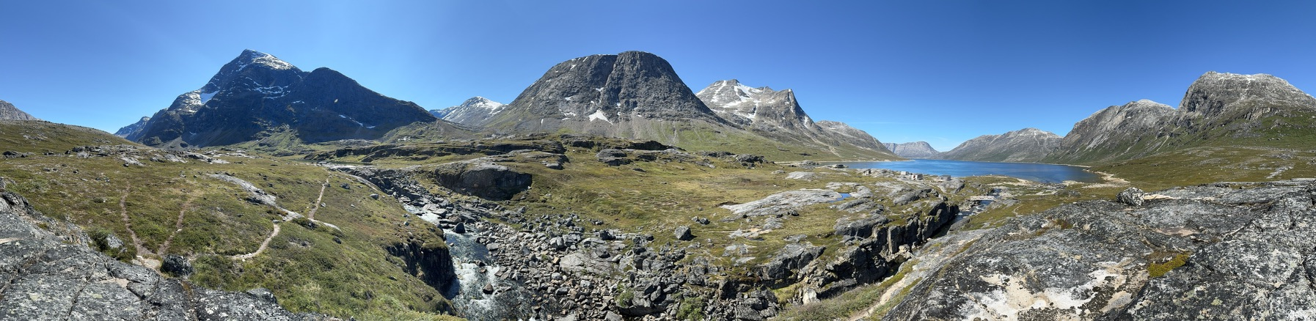
Vegetation data from Kangersluassunnguaq, Southeast Greenland
Ida Bomholt Dyrholm Jacobsen
Monday January 13th 2025
02935 Introduction to applied statistics and R for PhD students, Winter 2025

Slide 2
Data collection/source
100 circular 1 m² plots in a valley area in Southeast Greenland (randomised stratified sampling )
In each plot the following data was collected:
All taxa of vacular plants with (1 – 14 species)
abundance (Braun-Blanquet, 8 step scale)
Max heigh (cm)
Bare ground abundance
Lichen abundance
4 replicates of soil moisture (0 – 106 %, mean calculated)
4 replicates of soil temperature (1.5 – 23 °C, mean calculated)

Slide 3
Braun-Blanquet score for abundance estimates
Cover ranges (%) | Braun Blanquet | Center
0 | 0 | 0
0.00-0.02 | i (Species represented by a single individual) | 0.01
0.02-0.04 | r (<5; less than 1% plot cover, 3-5 individuals) | 0.03
0.04-0.2 | + (<5 %; few individuals) | 0.12
0.2-5 | 1 (<5 %; numerous individuals) | 2.6
5-25 | 2 (5-25 %) | 15
25-50 | 3 (25-50 %) | 37.5
50-75 | 4 (50-75 %) | 62.5
75-100 | 5 (75-100 %) | 87.5
Interval data
(Percentage groups)

Slide 4
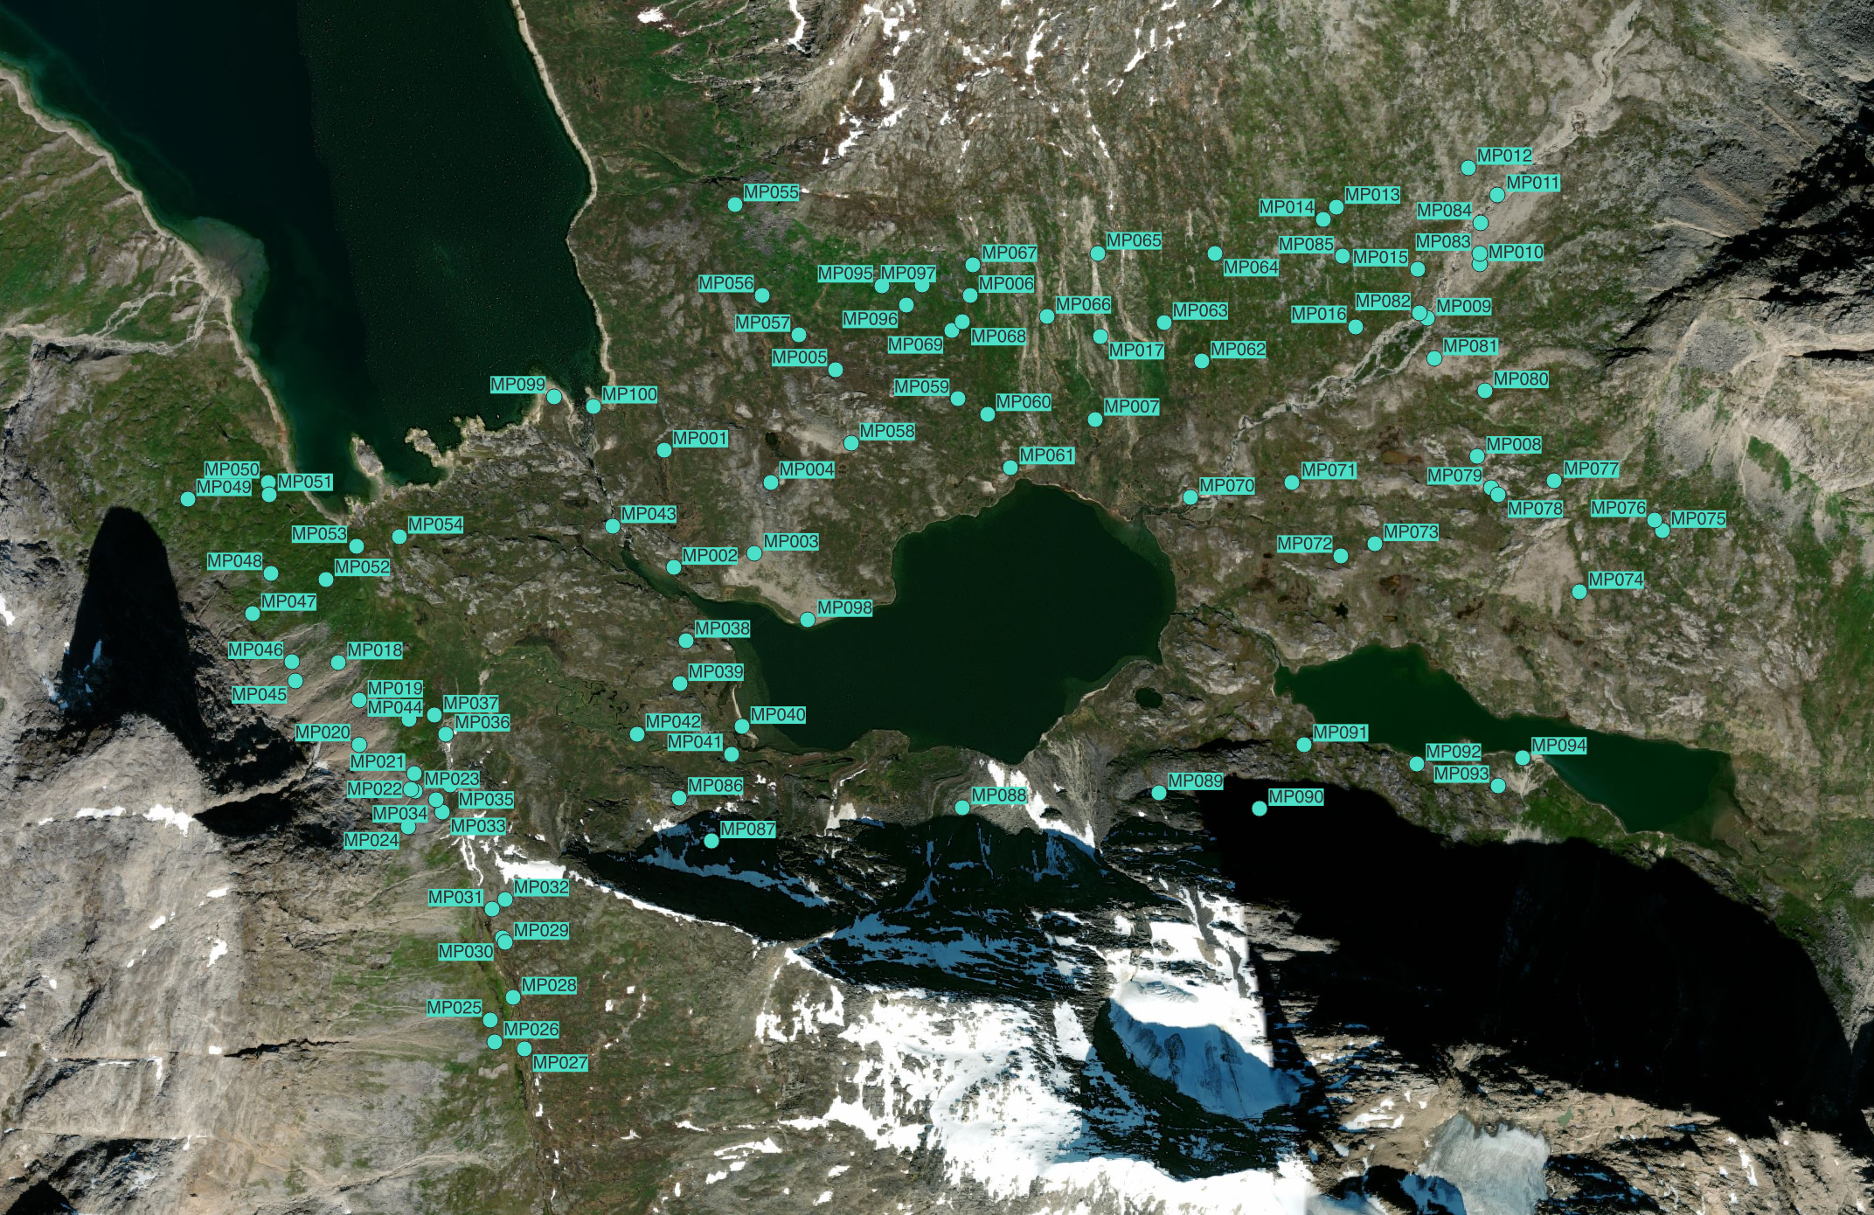
Kangersluassunnguaq

Slide 5
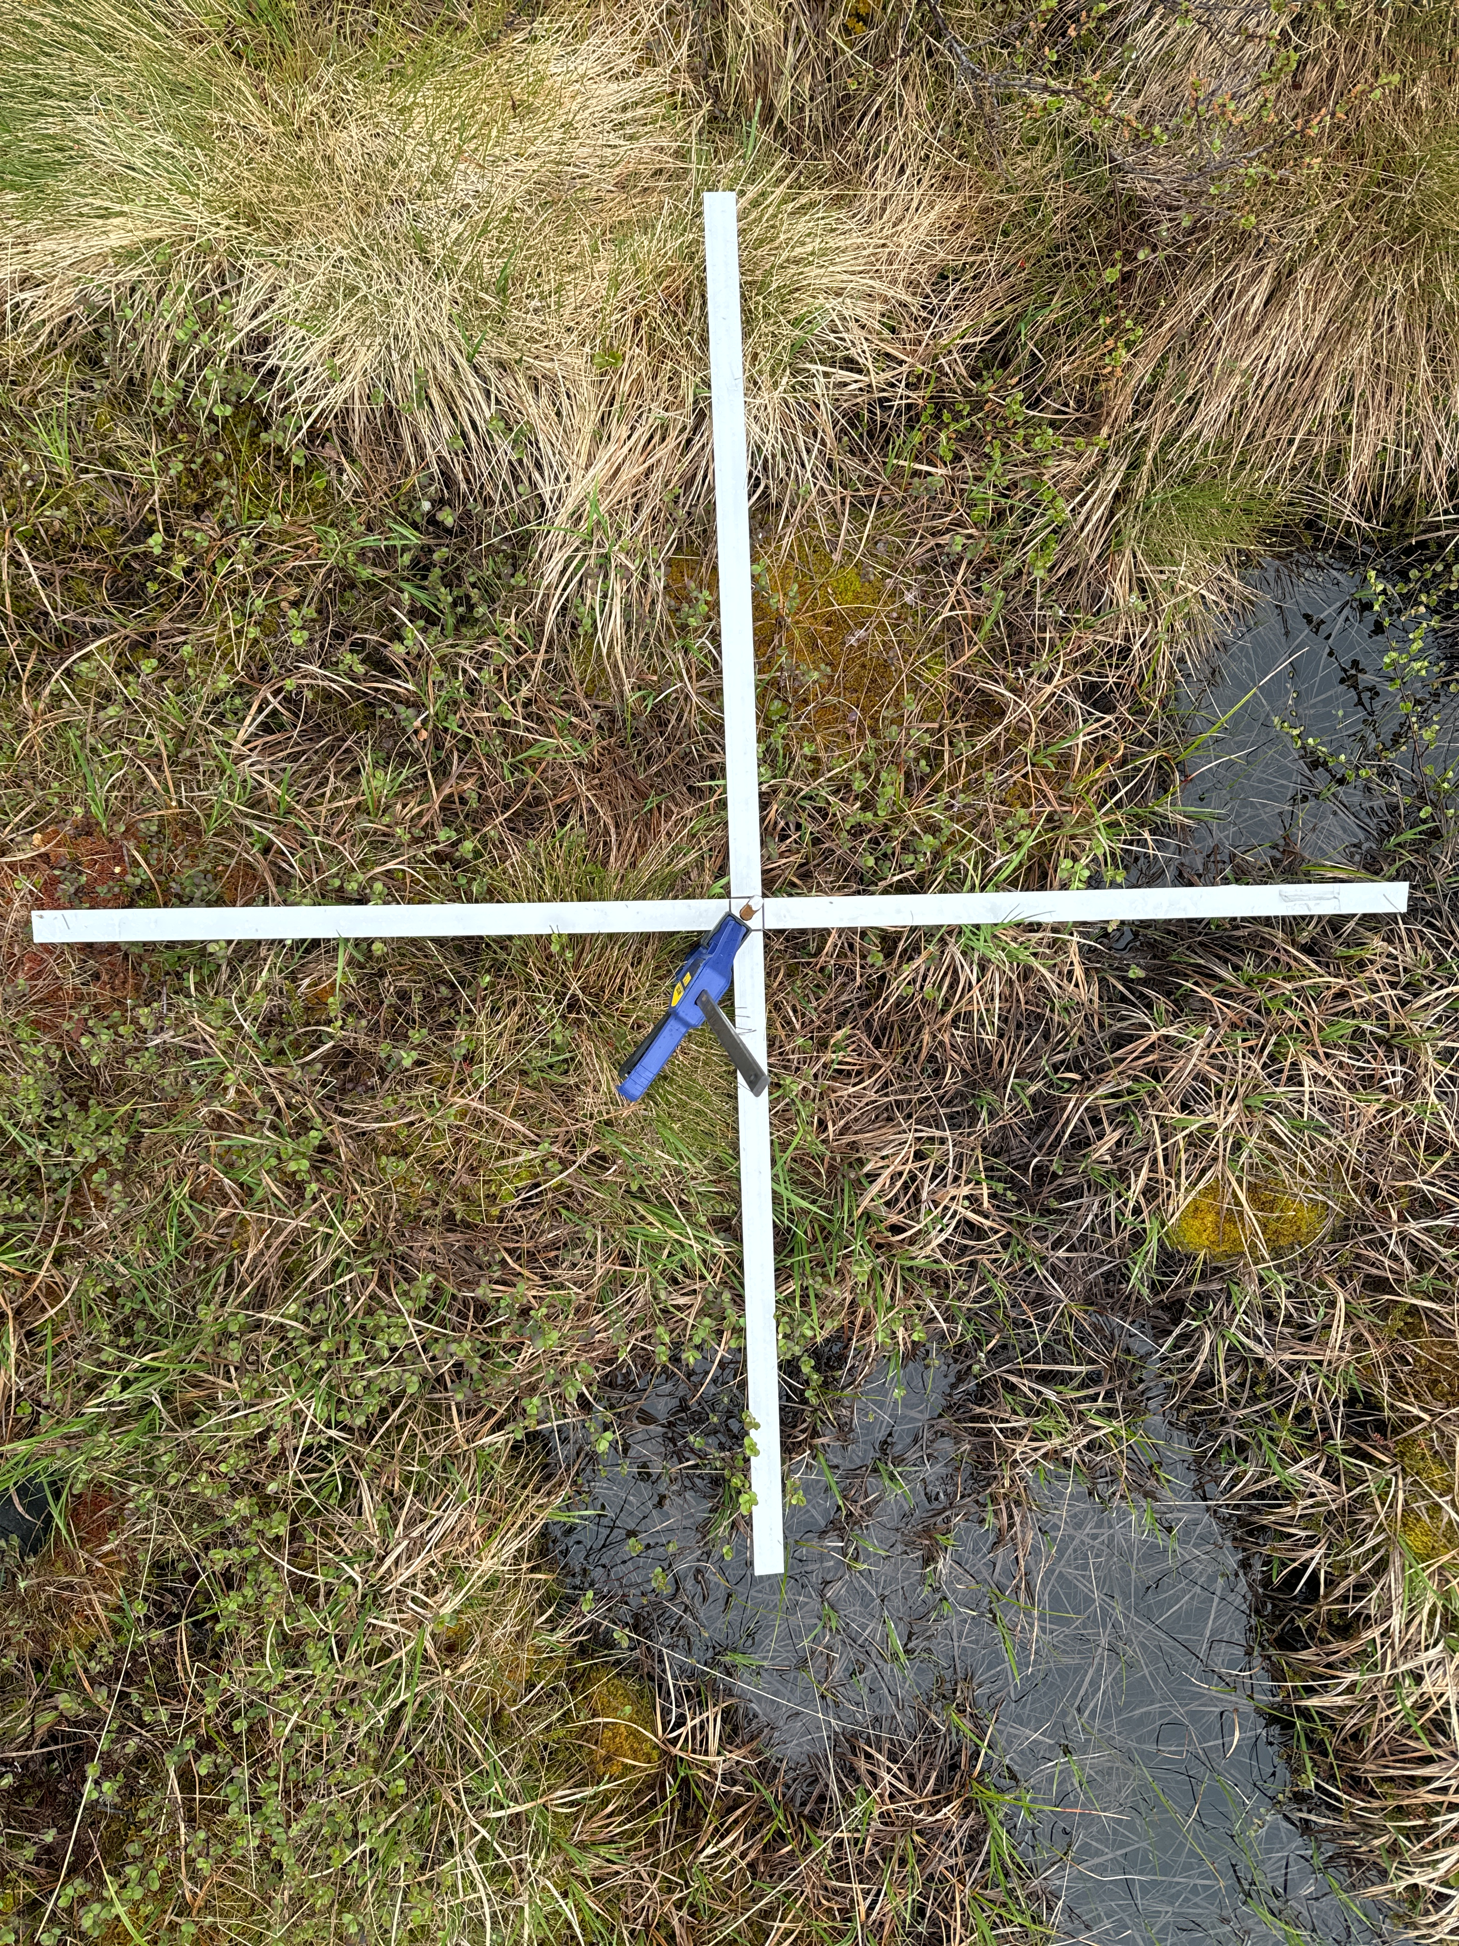
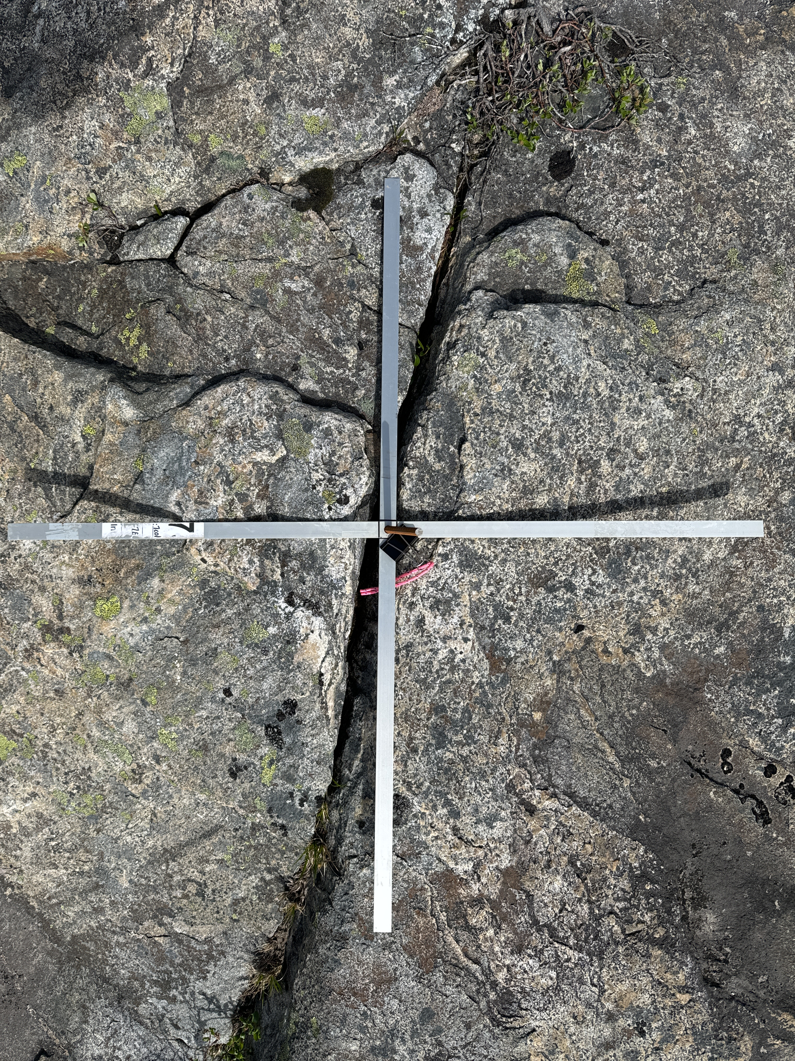

Slide 6
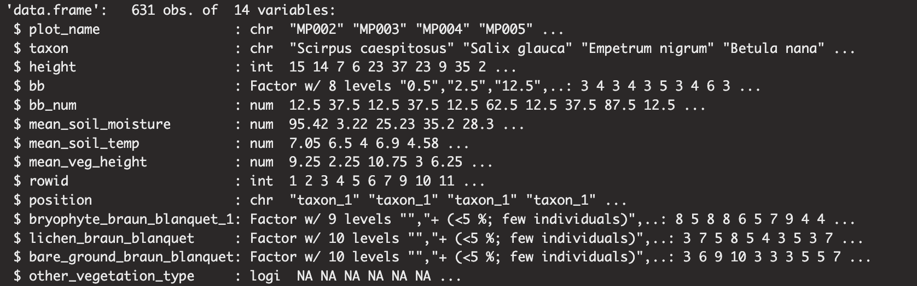
Data types

Slide 7
Tentative research question
1. Can this data be used to describe different plant species preferences (abundance) for soil moisture? (The relationship and interactions) Look at the fish grazing exer, env data; ozon demo in slides
Is the mean soil moisture of plots with xx species different from the mean soil moisture of plots with out xx species? Slopes for the species
How many observations of a species are needed to determine preference for soil moisture?
2. Can I detect any structures in this data based on the species composition (and or relate these to soil temperature or moisture)? (PCA)
Does PCA indicate any kind of groupings?
With abundance or presence/absence data?

